Slide 1
Smart parking system
Name | ID

Slide 2
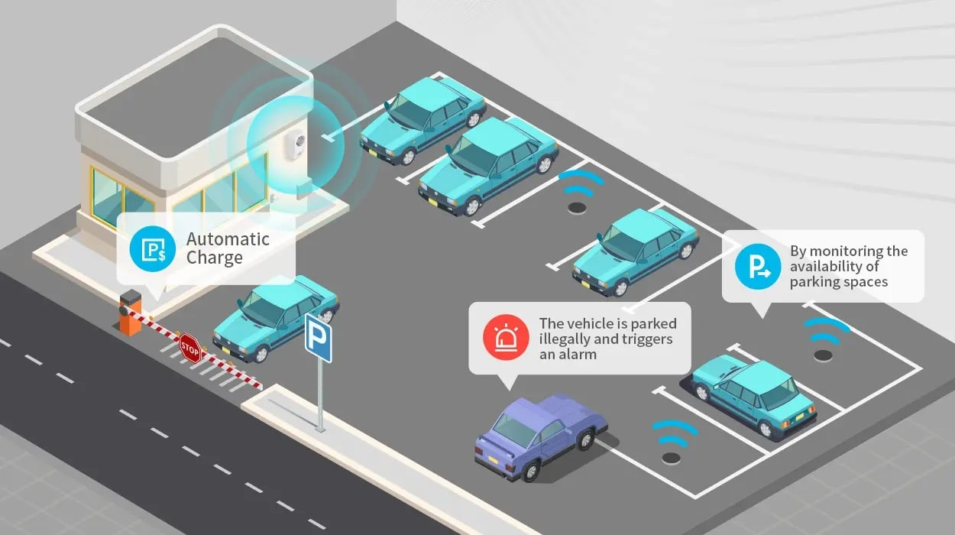
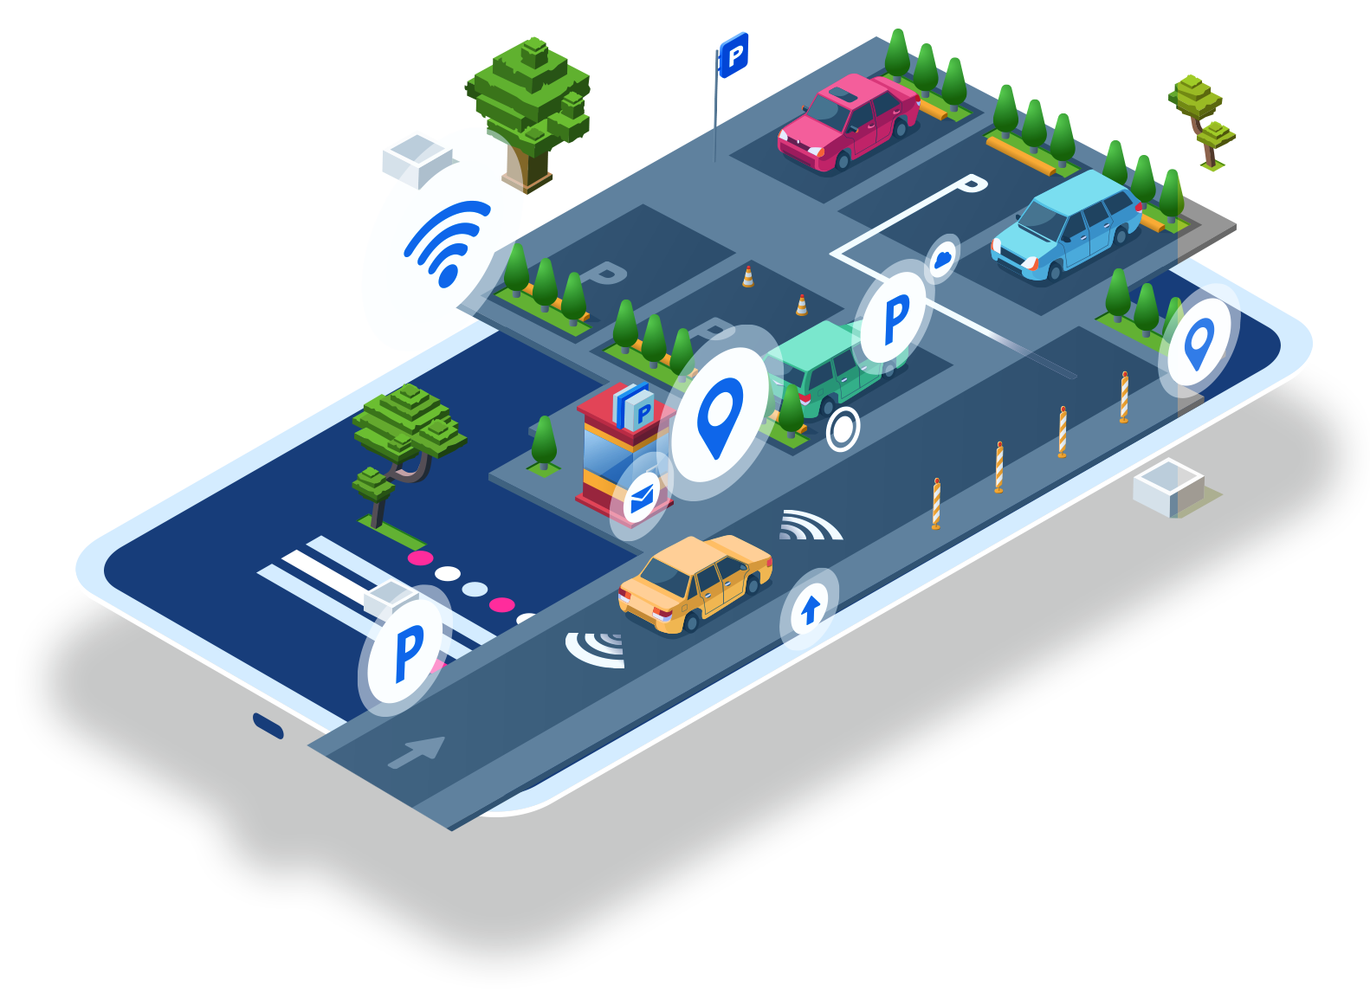
Introduction
Overview:
As the number of vehicles and people living in cities increases, the parking spaces become harder to find. The system uses an Arduino Uno and an ultrasonic sensor to find and inform drivers about available spaces, as well as improve the flow of traffic and safety.
Goals and Aims:
Automatically detect available parking spots.
The system can provide drivers with audible and visual feedback.
The project seeks to develop a cost-effective, reliable, and eco-friendly system that can work seamlessly with urban infrastructure.

Slide 3
List of Standards
Standard | Type | Description
ISO 21282:2019 | International | The project's requirements include the design and implementation of an intelligent transport system for parking management.
KS 1526 | National (Kuwait) | The project's electrical and electronic equipment needs to meet safety and environmental compatibility standards.
GSO IEC 62368-1 | Regional (GCC) | The project's electronic and electrical equipment must meet the requirements for safety and environmental compatibility.

Slide 4
List of Constraints
Category | Requirement
Functional | Detect car presence and parking status.
Safety | Meet KS 1526, GSO IEC 62368-1 standards.
Manufacturing | Use locally available components.
Economic | Stay within 35 KD budget.
Quality | Reliable in all weather conditions.
Aesthetic | Compact and modern design.
Legal/Ethical | Follow data privacy and telecom laws.
Sustainability | Use eco-friendly materials.
Timing | Complete in 13 days.

Slide 5
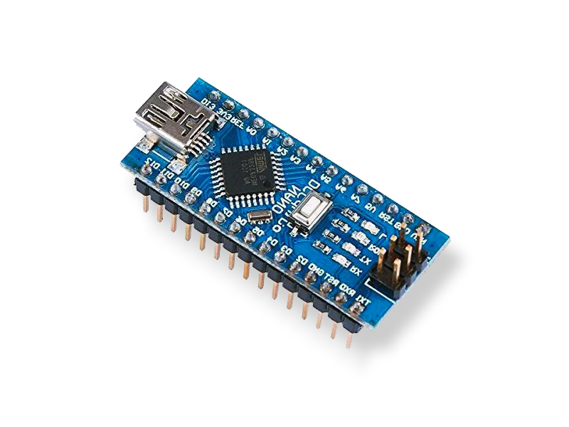

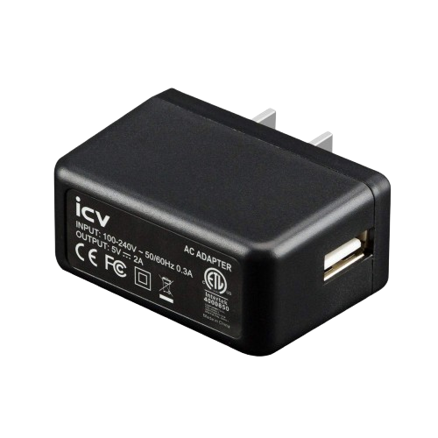
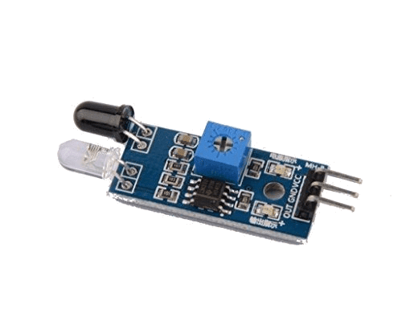
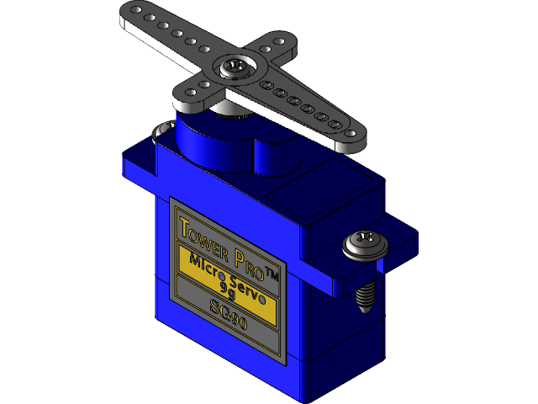

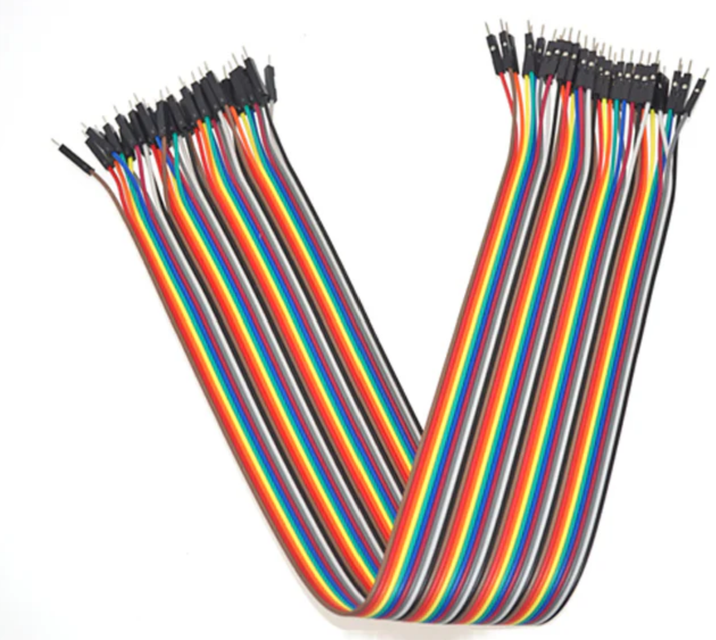
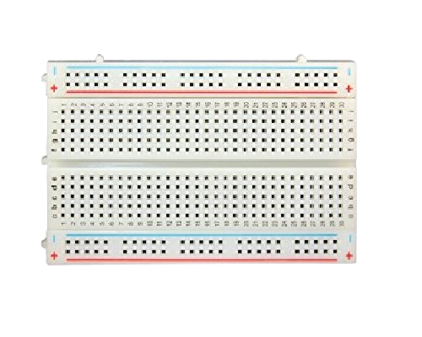
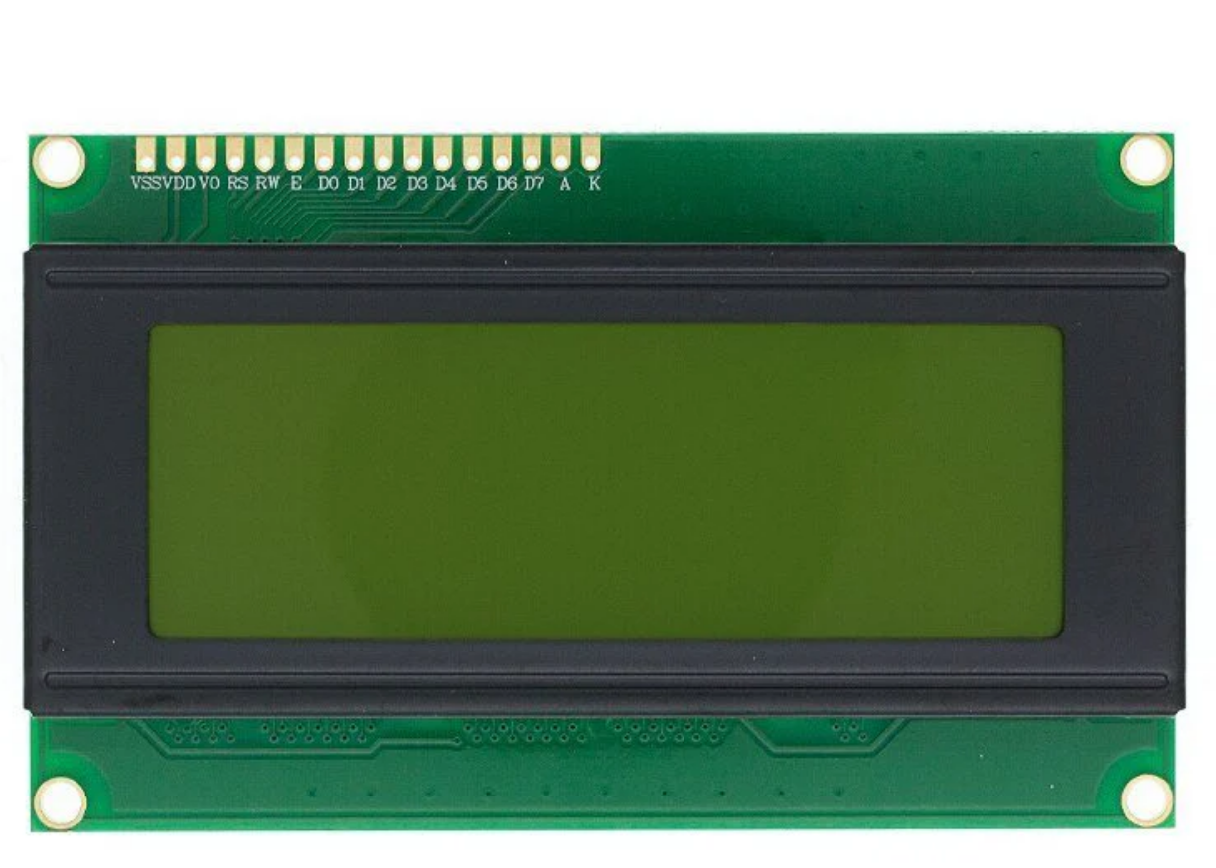
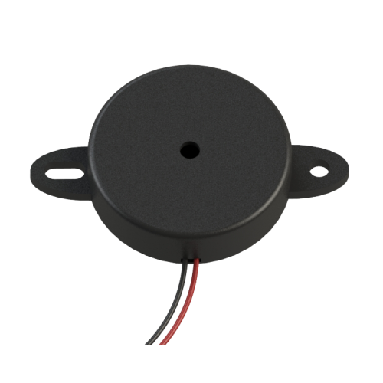
Components
IR Sensor (8 Pieces)
Arduino Nano (1 Piece)
Power Switch (1 Piece)
Adapter 5V 2A with socket (1 Piece)
Servo Motor SG90 (1 Piece)
M-F Wire 40cm (40 Pieces)
M-M Wire 30cm (20 Pieces)
Breadboard 400 pins(1 Piece)
LCD I2C 20x4 (1 Piece)
Buzzer (1 piece)

Slide 6
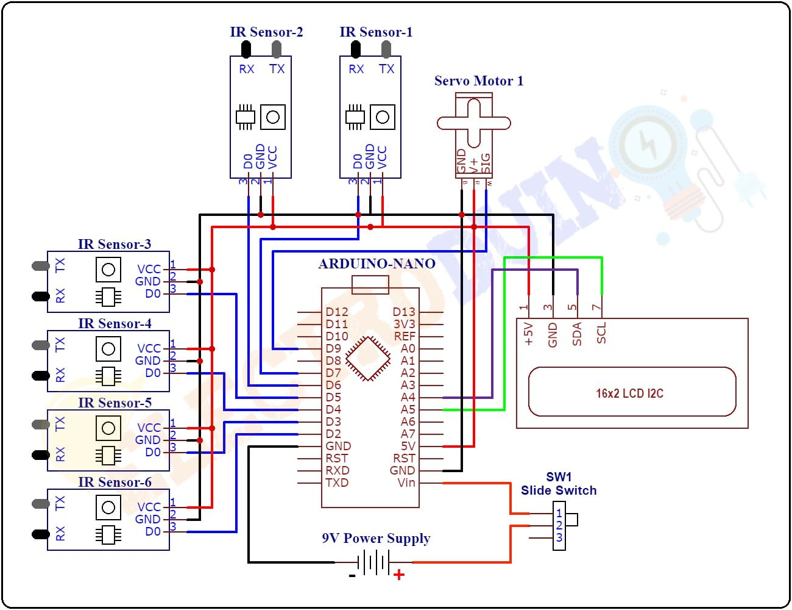
Prototype Structure
Keywords:
Six IR sensors connect to D2–D7 for detection.
Servo motor on D9 for movement control.
I2C LCD on A4 (SDA) and A5 (SCL) for display.
Powered by 9V battery with slide switch control.

Slide 7
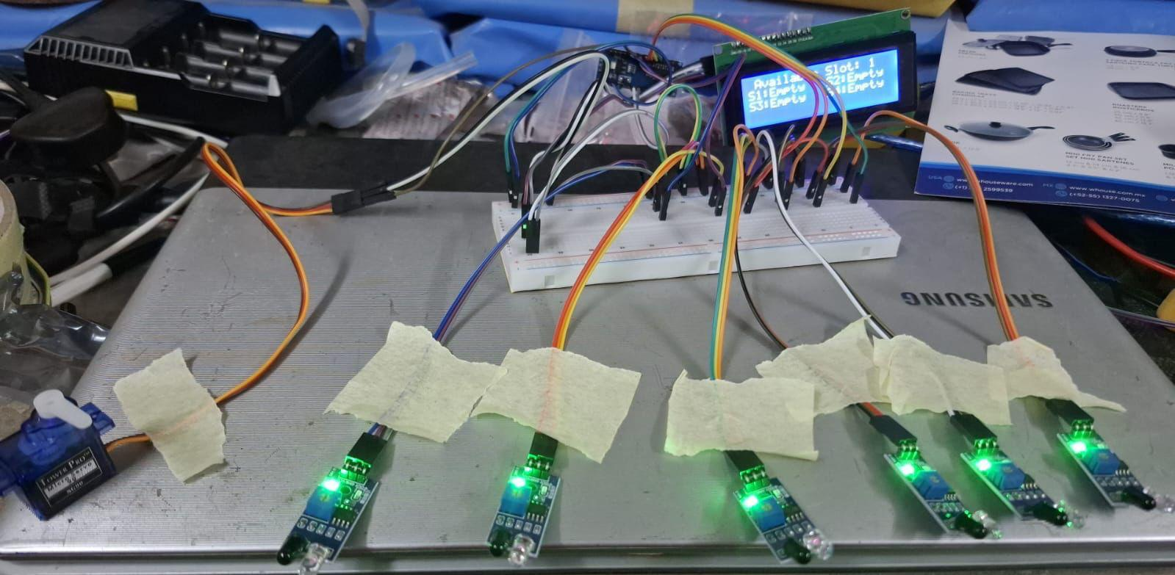
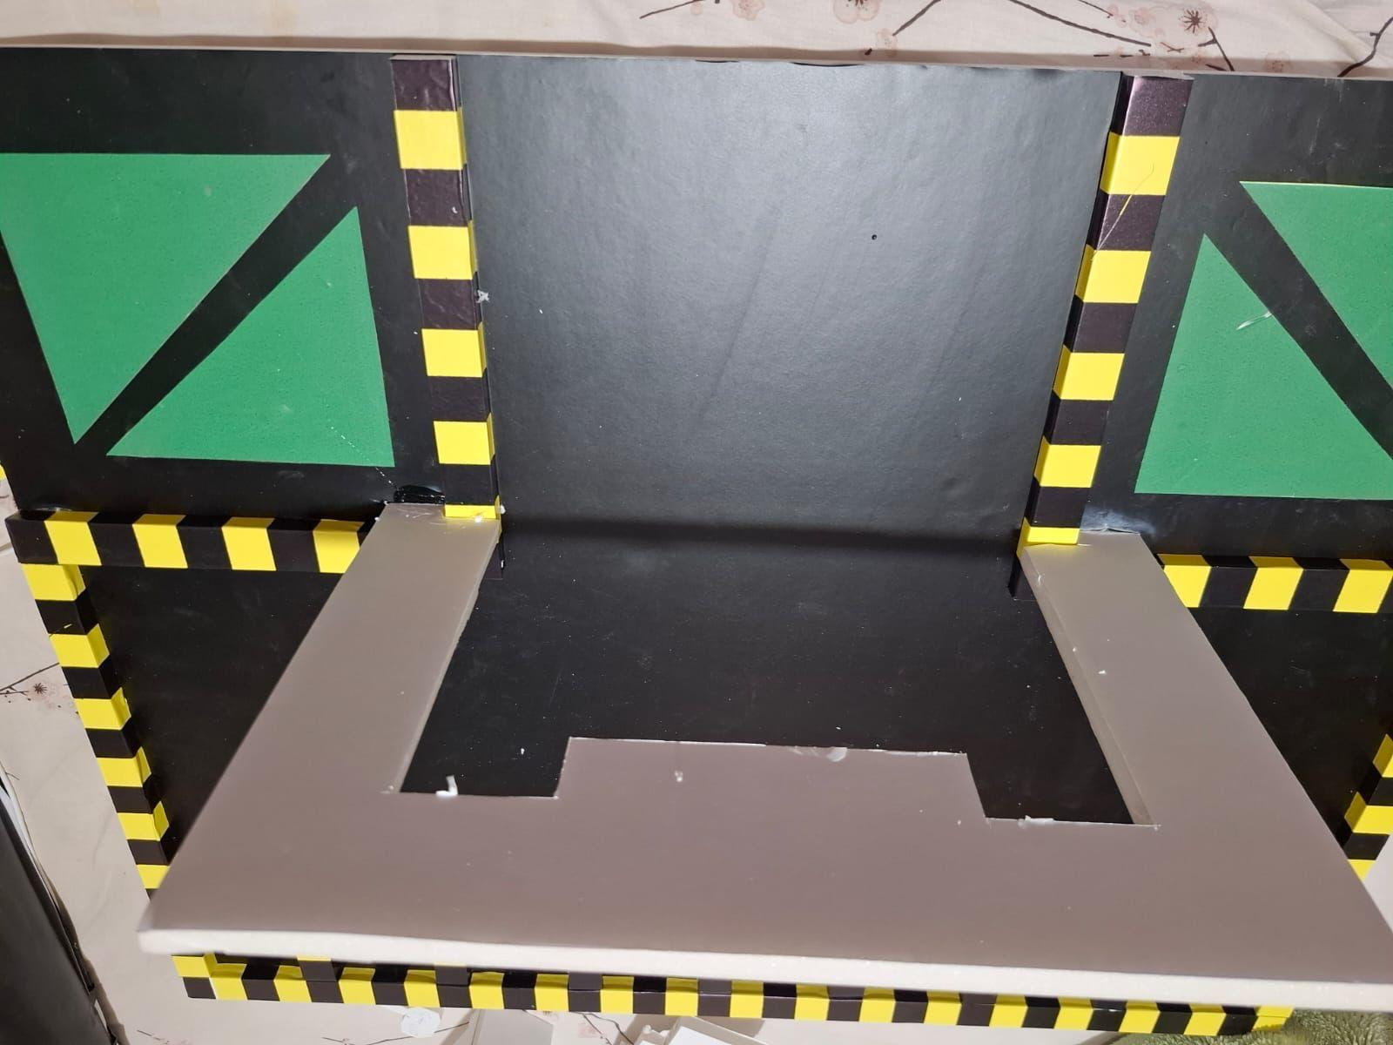
Prototype Figure

Slide 8
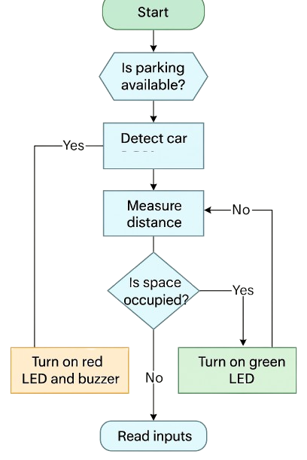
Flowchart
Keywords:
The system's initial step is to check if there's a parking space available.
If the system detects a car, it can then measure the distance traveled.
If the space is occupied, a red-colored buzzer and green-colored LED turn on, while lights on if it's not occupied will switch off.
loop will continue reading inputs to maintain real-time updates.

Slide 9

Project Reflection
Keywords:
Learn how to use sensors and the Arduino to solve real-world problems.
Developing one's debugging, coding, and circuit building abilities will make them more confident.
Developing a good understanding of the various constraints of a project will allow one to make informed decisions.
The ability to apply technology to practical problems improved my confidence.

Slide 10

Conclusion
Keywords:
able to create a smart parking system with the help of sensors and the Arduino.
The system can also tell the status of the parking area.
The project was able to meet various constraints, such as time, budget, and local availability.
Through this project, I was able to gain hands-on experience with various electronics and coding techniques.

Slide 11
References
Arduino. (n.d.). How to use ultrasonic sensor with Arduino. Arduino Get Started. https://arduinogetstarted.com/tutorials/arduino-ultrasonic-sensor
Ansar, M. (2021). How to make Arduino car parking assistant | Automated car parking indicator system [Video]. YouTube. https://www.youtube.com/watch?v=GppGzB4gRDw
International Organization for Standardization. (2019). ISO 21282:2019 – Intelligent transport systems – Parking management system requirements. https://www.iso.org/standard/70739.html

